Slide 1
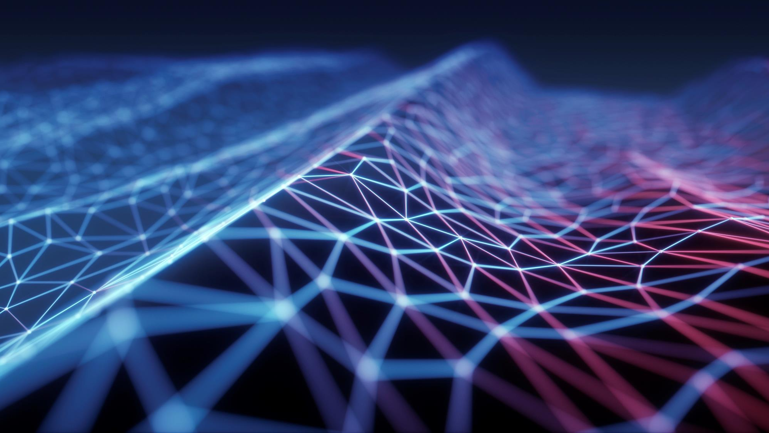
HYDROELECTRIC POWER
S.T.E.M. CROSS-CURRICULUM PROJECT DIANA MOORE AND SAM ELY

Slide 2
RATIONALE
This cross-curriculum project is designed to help spur innovation and growth in the hydropower energy technologies industry and support workforce development.

Slide 3
STANDARDS
AP Environmental Science
SEV4a The effects of human activities (fishing, water use, pollution, desalination, waster water treatment) on natural resources (land, air, water, organisms).
SEV5c The ecological effects of human innovations (Agricultural, Industrial, Medical, and Technological Revolutions) on global ecosystems.
STEM-FE-10
10.7 Analyze change as a result of data differences and changing environmental values.
10.9 Recognize the value of the reiterative process to improve data and to improve the design process.
STEM–FE-11
11.2 Use the protocols in science and mathematics to integrate solutions related to technical, electronic, or engineering activities using the content and concepts related to the situation or problems.
11.4 Communicate and collaborate with others on inquiry or resolution of issues/problems in the global community.

Slide 4
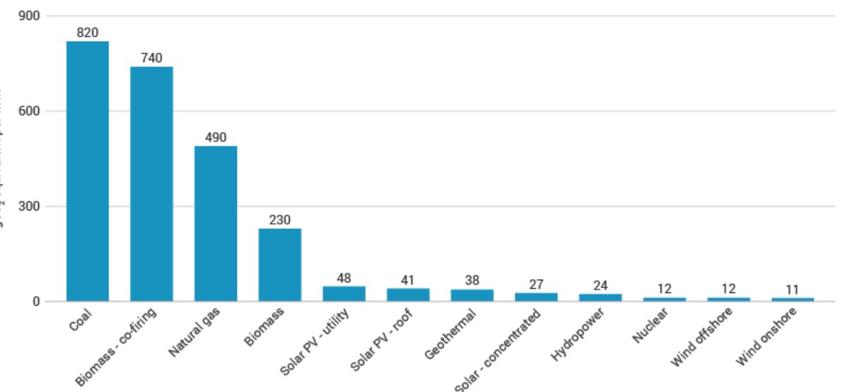
HOW MUCH EMISSION OF CARBON DIOXIDE IN THE ATMOSPHERE
Worldwide emissions of carbon dioxide (CO₂) from burning fossil fuels total about 34 billion tonnes (Gt) per year. About 45% of this is from coal, about 35% from oil and about 20% from gas. The impacts of electricity generation go beyond the emission of CO₂ and other greenhouse gases.

Slide 5
HEAT AND METHANE
The climate effect of burning fossil fuels is 100,000 times greater than the amount of heat given off while burning the fuel. Jun 2, 2015
Fossil fuel operations globally emitted close to 120 million tons of methane in 2020, nearly one-third of all methane emissions from human activity. Much of these emissions are simply leakage along the production and supply chain that operators fail to capture or avert.
Hydroelectric energy is made from the constant motion of the water cycle and it is the result of solar heat and the gravitational forces from the earth.
Hydropower is better for the environment than other major sources of electrical power, which use fossil fuels. Hydropower plants do not emit the waste heat and gases—common with fossil-fuel driven facilities—which are major contributors to air pollution, global warming and acid rain.

Slide 6
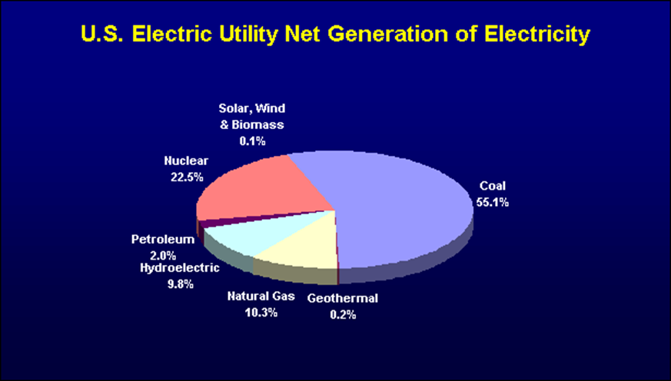
WORLD-WIDE, ABOUT 20% OF ALL ELECTRICITY IS GENERATED BY HYDROPOWER.
Hydropower provides about 10% of the electricity in the United States

Slide 7
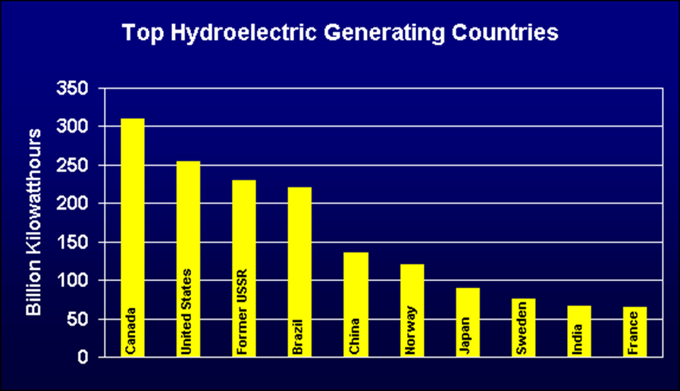
THE UNITED STATES IS THE SECOND LARGEST PRODUCER OF HYDROPOWER IN THE WORLD. CANADA IS NUMBER ONE.

Slide 8
Norway produces more than 99% of its electricity with hydropower. New Zealand uses hydropower for 75% of its electricity.
In the U.S., hydropower produces enough electricity to serve the needs of 28 million residential customers. This is equal to all the homes in Wisconsin, Michigan, Minnesota, Indiana, Iowa, Ohio, Missouri, Nebraska, Kansas, North and South Dakota, Kentucky, and Tennessee. ⁽¹⁾
In Wisconsin, hydropower accounts for 4.1% of the electric generating capacity and 4.4% of the total electricity generated

Slide 9
ENVIRONMENT
Hydropower is clean. It prevents the burning of 22 billion gallons of oil or 120 million tons of coal each year. ⁽¹⁾
Hydropower does not produce greenhouse gasses or other air pollution. ⁽¹⁾
Hydropower leaves behind no waste. ⁽¹⁾
Reservoirs formed by hydropower projects in Wisconsin have expanded water-based recreation resources, and they support diverse, healthy, and productive fisheries. In fact, catch rates for gamefish like walleye and smallmouth bass are substantially higher on hydropower reservoirs than natural lakes. ⁽³⁾

Slide 10
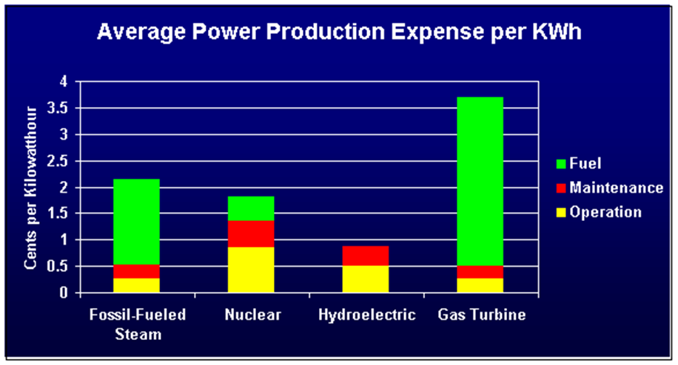
COST
Hydropower is the most efficient way to generate electricity. Modern hydro turbines can convert as much as 90% of the available energy into electricity. The best fossil fuel plants are only about 50% efficient. ⁽¹⁾
In the U.S., hydropower is produced for an average of 0.85 cents per kilowatt-hour (kwh). This is about 50% the cost of nuclear, 40% the cost of fossil fuel, and 25% the cost of using natural gas.

Slide 11
RECENT DATA
Only 2,400 of the nation's 80,000 existing dams are used to generate power. Installing turbines in existing dams presents a promising and cost-effective power source. However, in the last 10 years the Department of Energy has spent $1.2 billion on research and development for other renewable sources like wind, solar, and geothermal, but only $10 million on hydropower. ⁽¹⁾
Hydro fared better in terms of total construction cost, coming in at about $2.5 billion in 2016, compared with solar at nearly $20 billion and wind at nearly $15 billion.
A new study by Stanford engineer Mark Jacobson and his team published in the journal Energy & Environmental Science calculates that the world would need to spend around $62 trillion to build up the wind, solar, and hydro power generating capacity to fully meet demand and completely replace fossil fuels.

Slide 12
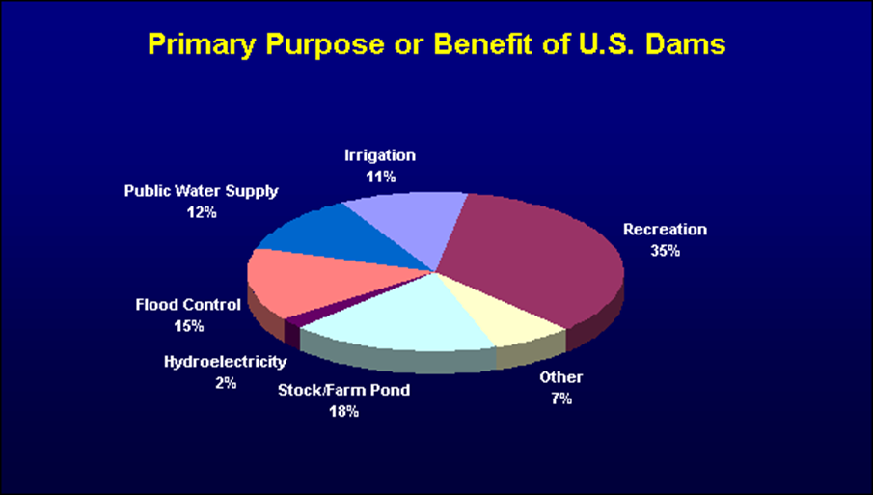
RENEWABLE ENERGY AND RECREATION ACTIVITIES
Hydropower is the leading source of renewable energy. It provides more than 97% of all electricity generated by renewable sources. Other sources including solar, geothermal, wind, and biomass account for less than 3% of renewable electricity production⁽¹⁾
Reservoirs formed by hydroelectric dams provide many water-based recreational opportunities including fishing, water sports, boating, and water fowl hunting. ⁽³⁾
Hydro operators own a significant amount of land around many reservoirs that is open to the public for uses including hiking, hunting, snowmobiling, and skiing. ⁽³⁾
Hydro operators provide many recreation facilities at their hydropower projects including boat landings, swimming beaches, restrooms, picnic areas, fishing piers, hiking and nature trails, canoe portages, and parking facilities. ⁽³⁾
Hydropower reservoirs contribute to local economies. A study of one medium-sized hydropower project in Wisconsin showed that the recreational value to residents and visitors exceeded $6.5 million annually

Slide 13
ADDITIONAL EXAMPLES
The Colorado River Basin has one of the most serious water supply problems in the U.S.
  Colorado River system provides water for more than 30 million people
    It irrigates 1.4 million acres of farmland
    Has 49 dams, 11 of which produce electricity.
    Niagara Falls
    It's New York State's biggest electricity producer, providing up to 2.6 million kilowatts of clean electricity. That clean energy is generated by two facilities, the Robert Moses Niagara Power Plant and the Lewiston Pump Generating Plant, with a combined 25 turbines spun by 748,000 gallons of water per second.
    The amount of electricity the power plants at Niagara Falls have the capacity to output is close to 4.9 million kilowatts. That's enough to power 3.8 millions homes. On the US side, plants have a capacity of roughly 2.7 million Kilowatts, while the Canadian side's combined capacity is close to 2.2 million kilowatts.

Slide 14
HOW AN ELECTRIC GENERATOR WORKS
An electric generator is a device used to convert mechanical energy into electrical energy.
The generator is based on the principle of "electromagnetic induction" discovered in 1831 by Michael Faraday, a British scientist. Faraday discovered that if an electric conductor, like a copper wire, is moved through a magnetic field, electric current will flow (be induced) in the conductor. So the mechanical energy of the moving wire is converted into the electric energy of the current that flows in the wire. As Faraday learned, moving the wire through the magnetic field causes electric current to flow in the wire In a hydroelectric plant, the generator is connected to transmission lines that deliver the electricity to your home or business.

Slide 15
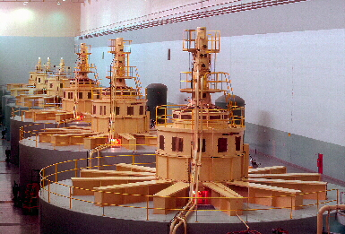
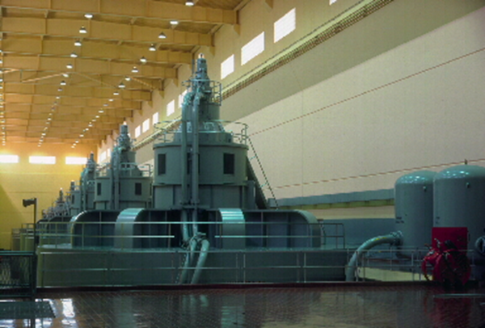
THE ACTUAL GENERATORS IN HYDROELECTRIC POWER PLANTS

Slide 16
